Slide 1

An Intelligent Customer Review Analysis and Opinion Mining Platform Using Natural Language Processing for Business Intelligence
DSA0307 - NATURAL LANGUAGE PROCESSING
PRESENTED BY:
C. Jaswanth(192424334)
M. Phanith Chandu(192425238)
S. Mahammed Nayeem(192425294)
B. Ganga Niranjan (192424041)
S. Tushar Krishna Sai (192424406)
GUIDED BY:
Dr. ANBAZHAGAN .K
PROFESSOR
CSE DEPARTMENT

Slide 2


ABSTRACT
The proposed system is a Customer Sentiment and Intent Analysis Platform for Business Intelligence.
It uses Natural Language Processing (NLP) to automatically analyze large volumes of customer feedback.
The system identifies customer sentiment as positive, negative, or neutral.
It detects customer intent, such as purchase, complaint, and inquiry.
BERT is used to detect toxic, offensive, abusive, and harmful comments.

Slide 3



INTRODUCTION
Businesses receive customer feedback from multiple sources daily.
Understanding customer opinions is important for business growth.
NLP enables automatic analysis of customer text data.
Sentiment and intent analysis provide valuable customer insights.
The platform supports data-driven business decisions.

Slide 4
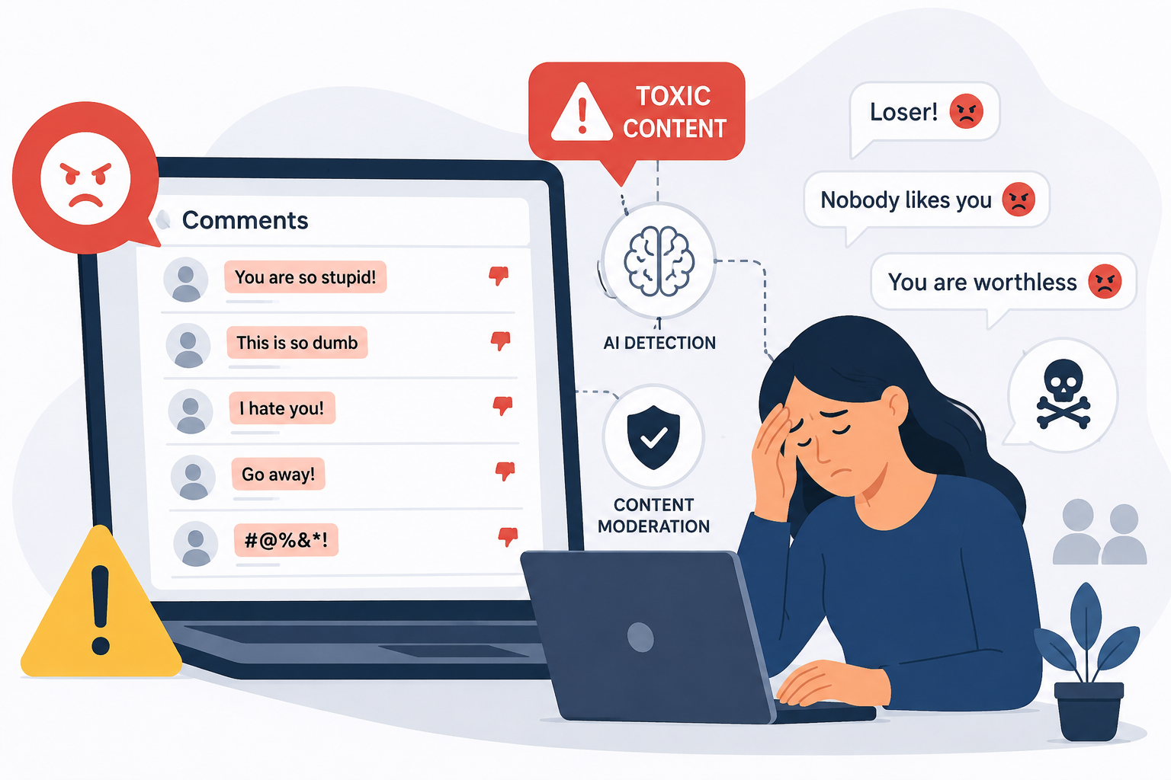
PROBLEM STATEMENT
Customer feedback is generated in large volumes.
Manual analysis is time-consuming and inefficient.
Important customer concerns may go unnoticed.
Businesses struggle to identify customer intentions accurately.
Delayed insights can affect customer satisfaction and revenue.

Slide 5
LITERATURE REVIEW
AUTHOR & YEAR | TITLE | KEY CONTRIBUTION | LIMITATIONS
Farshidi et al., 2026 | Understanding User Intent Modeling for Conversational Recommender Systems | Reviewed various user intent modeling techniques for understanding customer needs and improving recommendation systems. | Difficulty in handling dynamic user intentions and context changes.
Hua et al., 2025 | A Systematic Review of Aspect-Based Sentiment Analysis: Domains, Methods, and Trends | Analyzed Aspect-Based Sentiment Analysis (ABSA) methods for extracting fine-grained customer opinions. | Requires large annotated datasets and struggles with multilingual data.
Aziz et al., 2024 | Unifying Aspect-Based Sentiment Analysis BERT and Multi-Layered Graph Convolutional Networks | Improved sentiment classification accuracy using BERT and Graph Convolutional Networks. | High computational complexity and longer training time.
Alahmadi et al., 2024 | Generalizing Sentiment Analysis: A Review of Progress, Challenges, and Emerging Directions | Reviewed modern sentiment analysis approaches and emerging AI techniques. | Challenges in sarcasm detection, domain adaptation, and explainability.

Slide 6
EXISTING SYSTEM & PROPOSED SYSTEM
EXISTING SYSTEM | PROPOSED SYSTEM
Feedback is analyzed manually. | Feedback is analyzed automatically using NLP.
Processing customer data takes more time. | Provides faster analysis and results.
Difficult to handle large amounts of feedback. | Efficiently handles large-scale customer data.
Customer sentiment is identified manually. | Automatically detects sentiment and intent.
Higher chances of human errors. | Improves accuracy and consistency.
Limited support for business decision-making. | Generates insights and reports for better decisions.

Slide 7
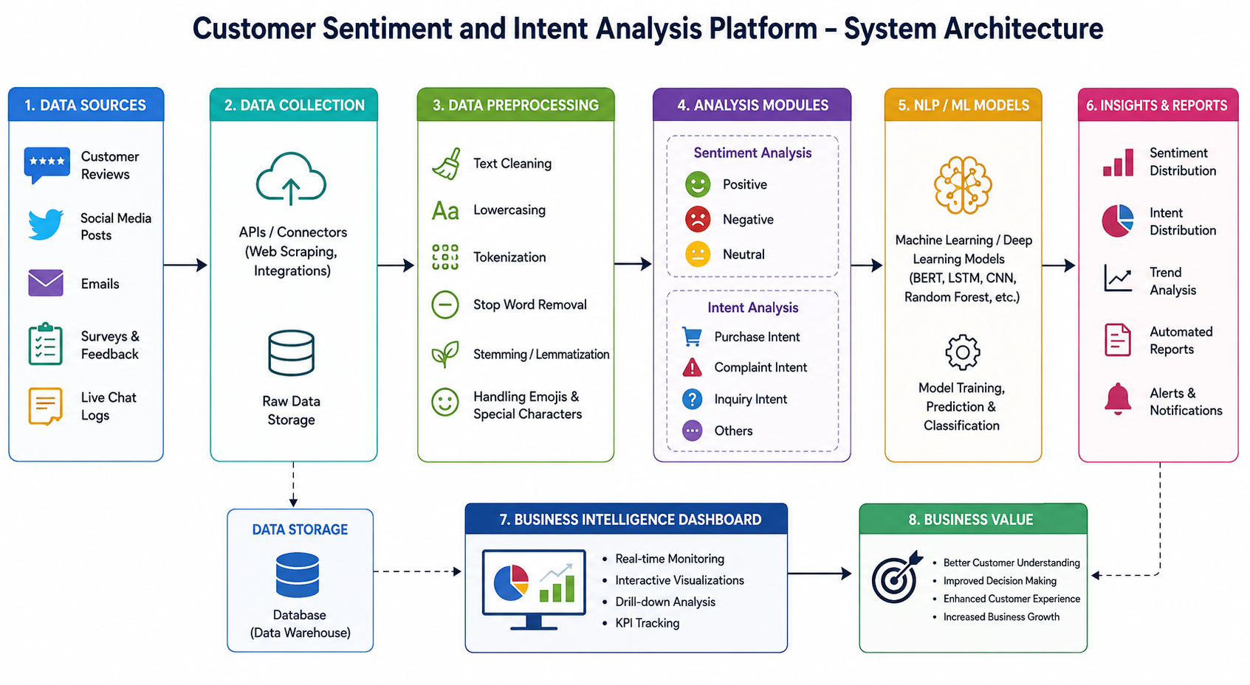
SYSTEM ARCHITECTURE

Slide 8
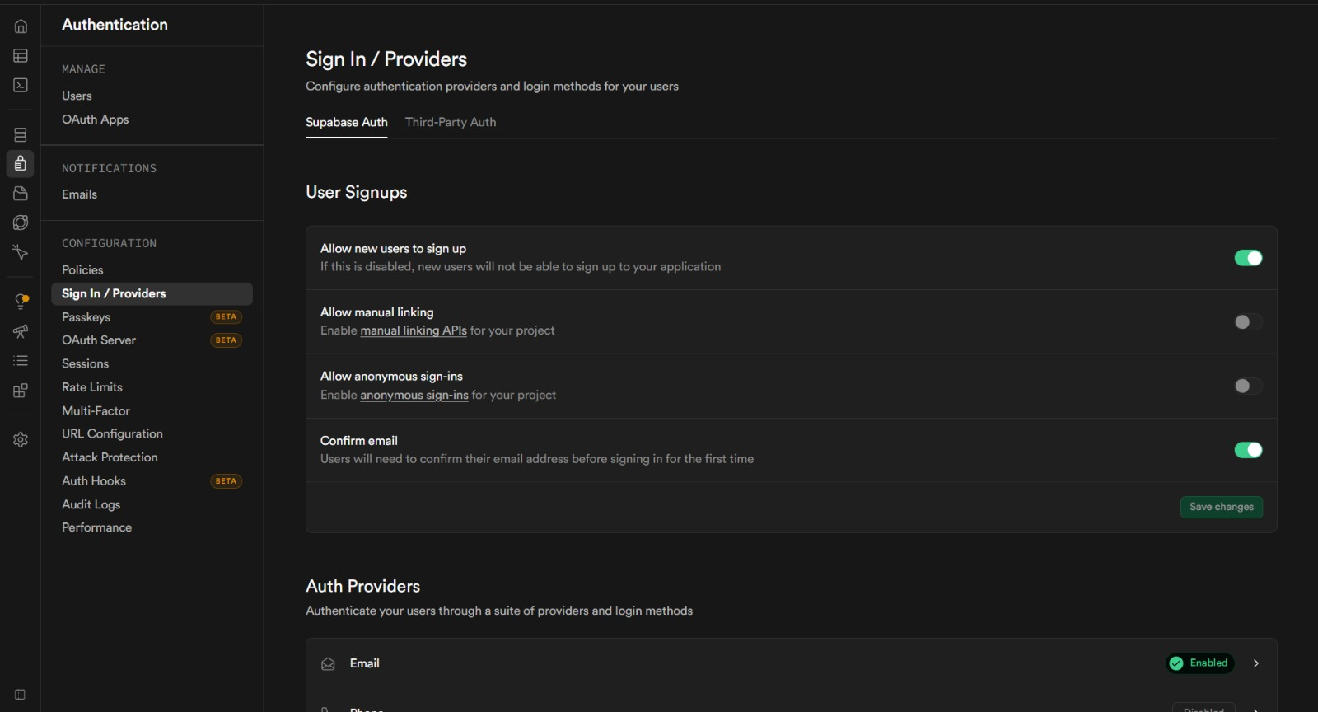
MODULE 1 USER AUTHENTICATION & DASHBOARD
User registration and secure login.
Role-based access control for users and administrators.
Dashboard for monitoring customer feedback.
Display summary of sentiment and intent results.
Manage user profiles and settings.

Slide 9
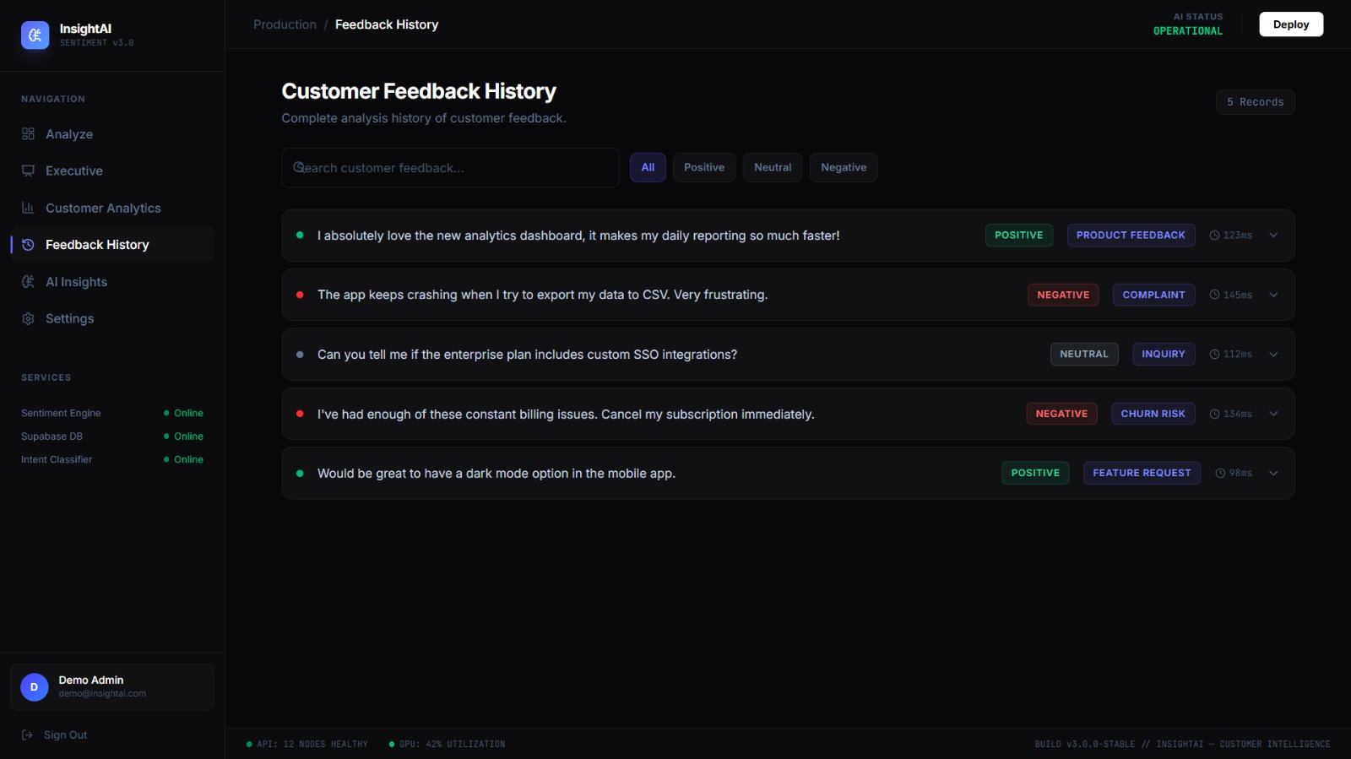
MODULE 2 DATA COLLECTION & NLP PREPROCESSING
Collect data from reviews, surveys, emails, and social media.
Remove noise, special characters, and irrelevant text.
Perform tokenization of customer feedback.
Apply stop-word removal and normalization.
Perform stemming and lemmatization.

Slide 10
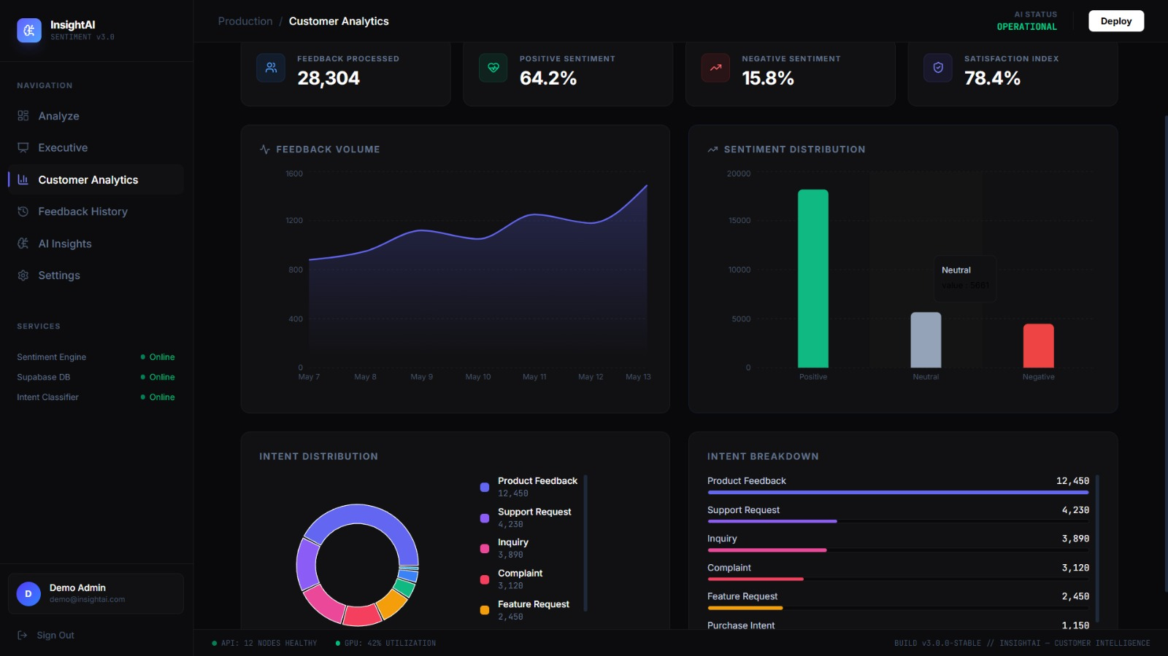
MODULE 3 BERT TOXIC COMMENT DETECTION
Uses the BERT deep learning model to analyze and understand text context.
Detects toxic, offensive, abusive, and harmful comments automatically.
Classifies comments into Toxic and Non-Toxic categories.
Improves detection accuracy by considering the meaning of words in a sentence.
Supports content moderation by identifying inappropriate user comments in real time.

Slide 11
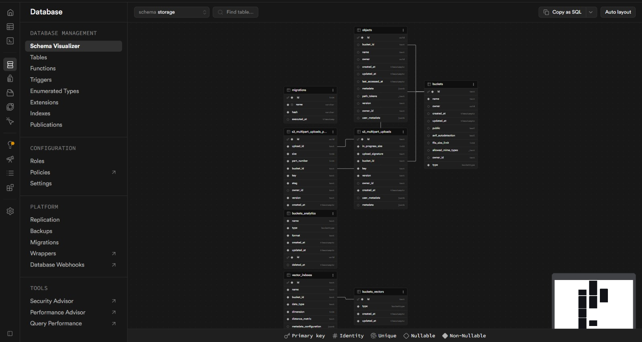
MODULE 4 DATABASE & BACKEND INTEGRATION
Detect customer intents such as Purchase, Complaint, and Inquiry.
Store processed customer data in a database.
Manage sentiment and intent records efficiently.
Retrieve historical customer interactions.
Support backend services and data management.

Slide 12
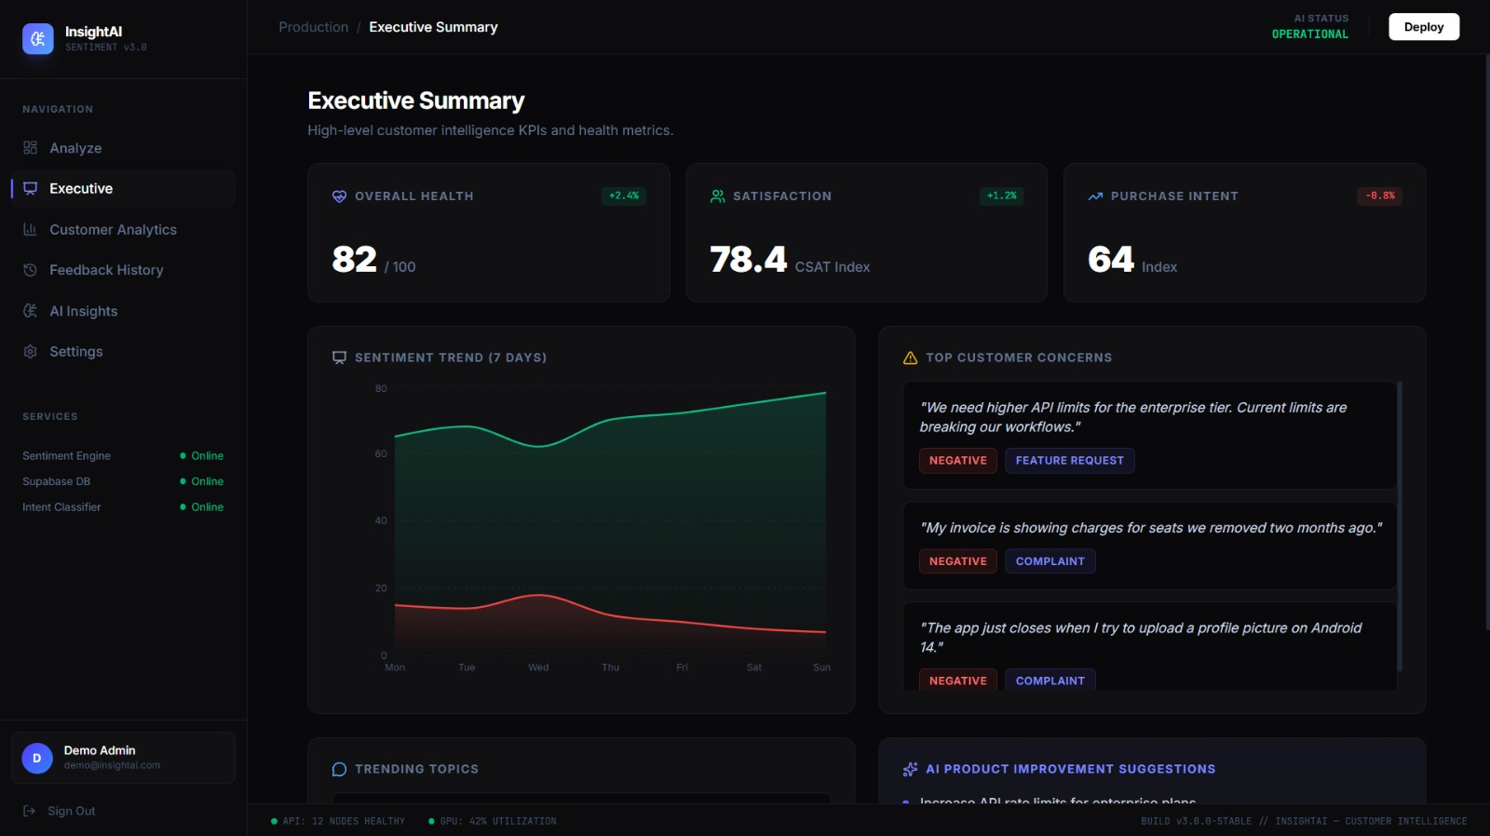
MODULE 5 ANALYTICS & MODERATION SYSTEM
Generate sentiment and intent distribution reports.
Visualize trends through charts and dashboards.
Monitor customer satisfaction metrics.
Identify business opportunities and customer issues.
Support data-driven decision making.

Slide 13

TOOLS AND TECHNOLOGIES
Python – Core programming language.
BERT – Toxic comment detection model.
NLTK & SpaCy – Text preprocessing and NLP tasks.
Flask– Backend development.
MySQL – Database management.
PyTorch – Model training and deployment.
Pandas & NumPy – Data handling and analysis.
VS Code – Development tools.

Slide 14

RESULT AND DISCUSSION
The system successfully detects toxic and non-toxic comments using the BERT model.
NLP preprocessing improves the quality of text analysis.
Toxic comments are accurately identified and flagged for moderation.
Non-toxic comments are approved and allowed for display.
Analytics and reports provide insights into user behavior and content trends.
The system helps maintain a safer and healthier online environment.

Slide 15

FUTURE ENHANCEMENTS
Support multilingual toxic comment detection.
Integrate real-time monitoring and alert systems.
Detect sarcasm, hate speech, and cyberbullying more accurately.
Improve model performance using advanced transformer models.
Develop a mobile application for easier access and moderation.
Add sentiment analysis and emotion detection features.

Slide 16
CONCLUSION
The system effectively identifies harmful and offensive comments.
BERT-based classification improves detection accuracy by understanding context.
NLP techniques enhance text preprocessing and analysis.
The system supports automated content moderation and reduces manual effort.
It contributes to creating a secure and user-friendly online platform.

Slide 17
REFERENCES
Farshidi, S., Jannach, D., & Jugovac, M. (2026). Understanding user intent modeling for conversational recommender systems: A systematic review. User Modeling and User-Adapted Interaction, 33(5), 1047–1085.
Hua, Y. C., Chen, P., & Zhang, H. (2025). A systematic review of aspect-based sentiment analysis: Domains, methods, and trends. Artificial Intelligence Review, 57(8), 1–40.
Jim, J. R., Kumar, S., & Sharma, P. (2025). Recent advancements and challenges of NLP-based sentiment analysis: A state-of-the-art review. Natural Language Processing Journal, 7, 100089.
Alahmadi, K., Alharthi, R., & Alghamdi, A. (2024). Generalizing sentiment analysis: A review of progress, challenges, and emerging directions. Social Network Analysis and Mining, 15(1), 1–25.
Baberwal, S., Sharma, A., & Gupta, R. (2024). Systematic review of recent advances in multimodal sentiment analysis. Information Systems Frontiers, 27(2), 1–22.

Slide 18


